Slide 1


LANL Team Update
10/02/2024
Izzy Baumler, Dalton Boeckmann, Morgan Gullo, Jade Waldron

Slide 2
Mission Statement
To design and prototype a semi-autonomous robotic arm that is attached to the Boston Dynamics Spot quadruped robot that can cover a 3 foot radius area.
-cover surface area of x
-semi-autonomous
-6 DoF movement
-can handle a weight of XX at the end

Slide 3
Weekly Updates
Revised and turned in DR1 revision
Continued kinematic and static analysis and research
Began brainstorming railing system design and layout
Meeting cancelled for customer needs due to South Carolina hurricane
Assigned Morgan Gullo as Project Manager

Slide 4
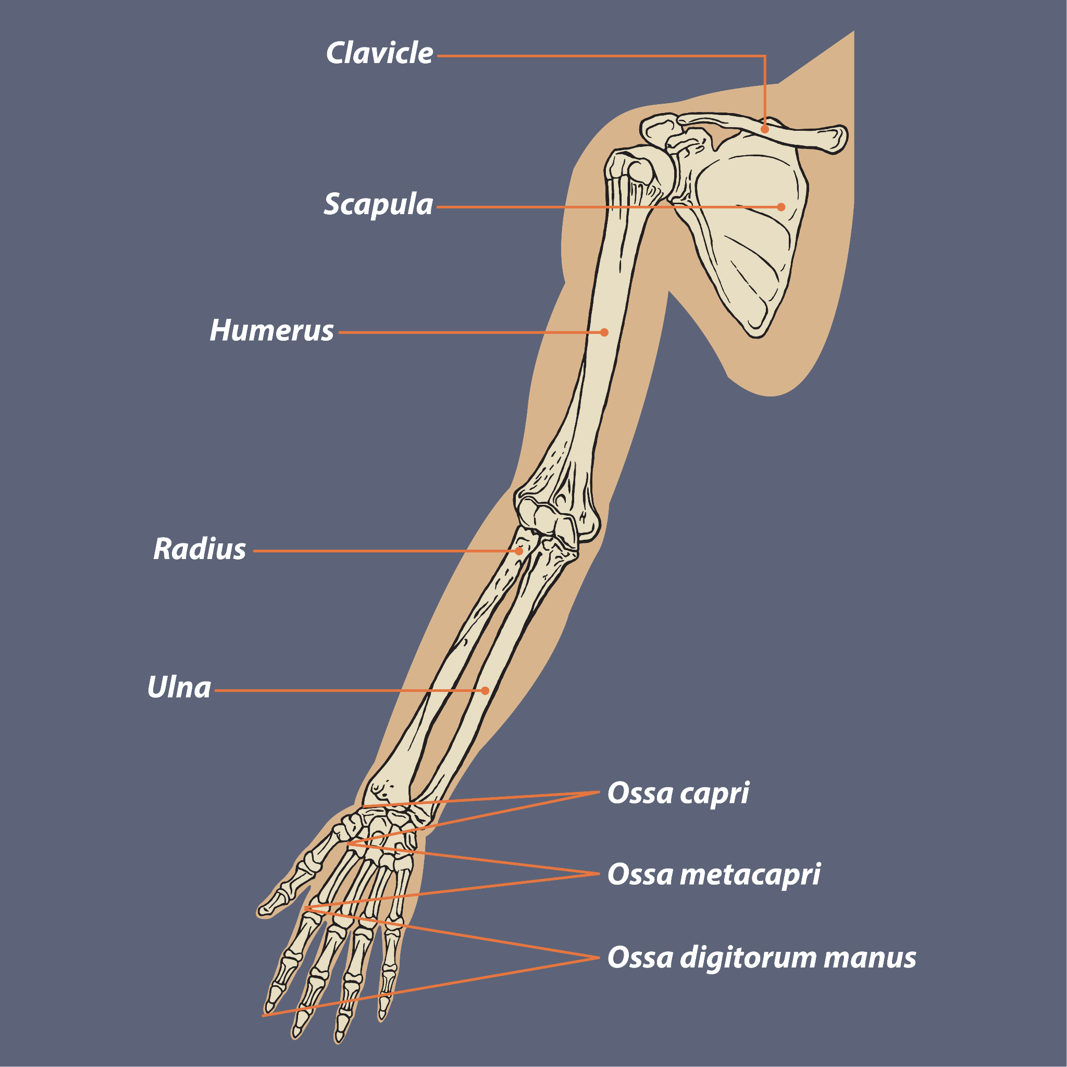
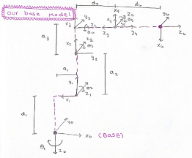
Kinematic Analysis - Dalton Boeckmann
Average Male (21 years old) cm
Bone | Left | Right
Humerus | 33.00 | 33.00
Ulna | 26.00 | 27.00
Radius | 25.00 | 25.00
Femur | 47.00 | 46.00
Tibia | 38.00 | 38.00
Fibula | 38.00 | 38.00
Denavit Hartenberg Parameters Table
Joint (N) | Θ | α | d | a
1 | 0.00 | -1.57 | 11.00 | 64.20
2 | -1.57 | 0.00 | 0.00 | 11.00
3 | 3.14 | 1.57 | 0.00 | 11.00
4 | 0.00 | -1.57 | 12.50 | 0.00
5 | 0.00 | 1.57 | 0.00 | 0.00
6 | 0.00 | 0.00 | 12.50 | 0.00

Slide 5
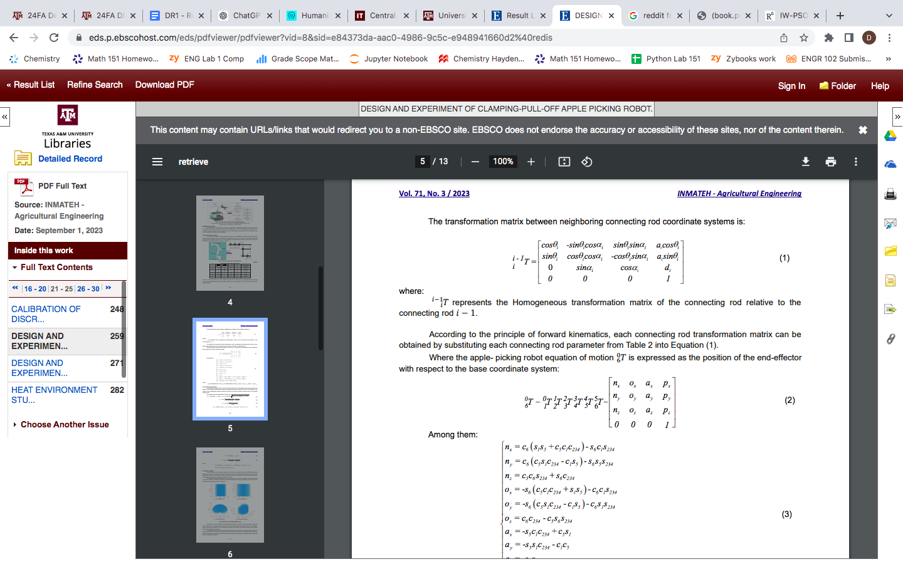
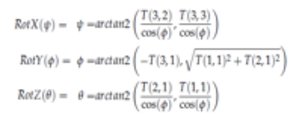
Kinematic Analysis - Dalton Boeckmann
Forward Kinematics for a 6 DoF Draft Robot
Input: Joint Angles of Rotation
Output: End Effector Position relative to Base
Utilizing Denavit Hartenberg Convention
4 Rules
4 Parameters (Θ,α,d,a)
Transformative Matrix for Each Joint
Final Homogeneous Transformation Matrix
What it can tell us about end effector Position and Rotation ?
Is Forward Kinematics Ideal for End effector Position and Control?
https://docs.google.com/spreadsheets/d/1n6bPuD8_kZOEpCN_uMg4ljr7ETDbH8Js-aryVri61Nk/edit?gid=0#gid=0

Slide 6
Kinematic Analysis - Dalton Boeckmann
Now Working on a Inverse Kinematic Analysis, to verify results, as well as better for control system in the future
Inverse Kinematics for a 6 DoF Draft Robot
Input: End Effector Position relative to Base
Output: Joint Angle and Angular Velocity
https://docs.google.com/spreadsheets/d/1n6bPuD8_kZOEpCN_uMg4ljr7ETDbH8Js-aryVri61Nk/edit?gid=0#gid=0

Slide 7
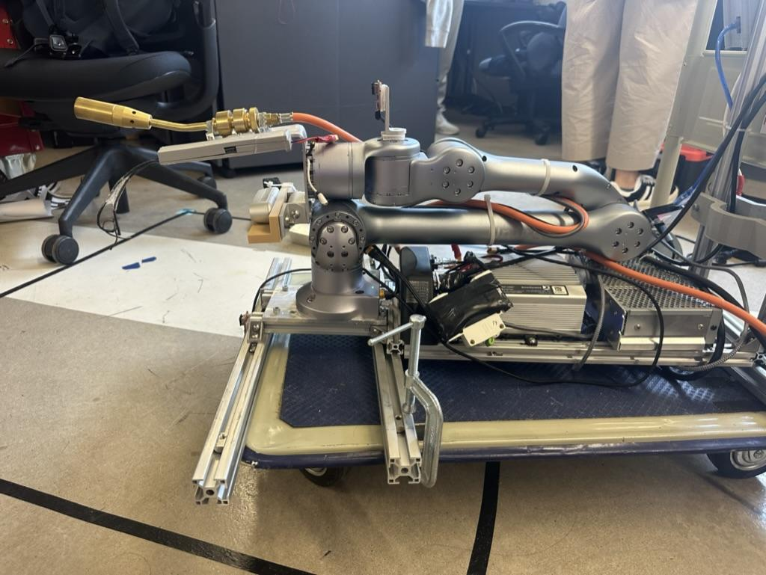
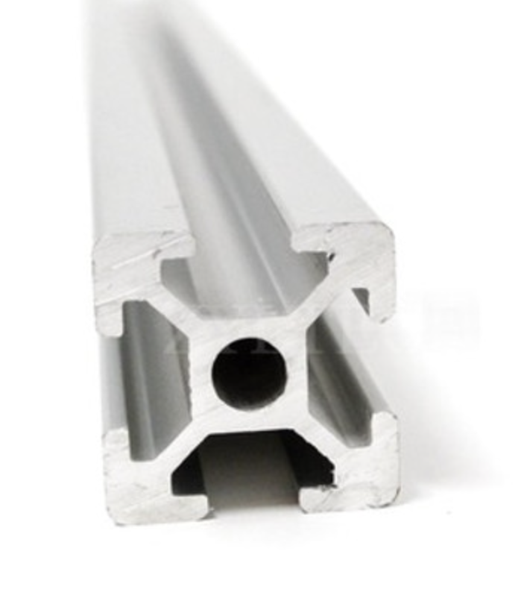
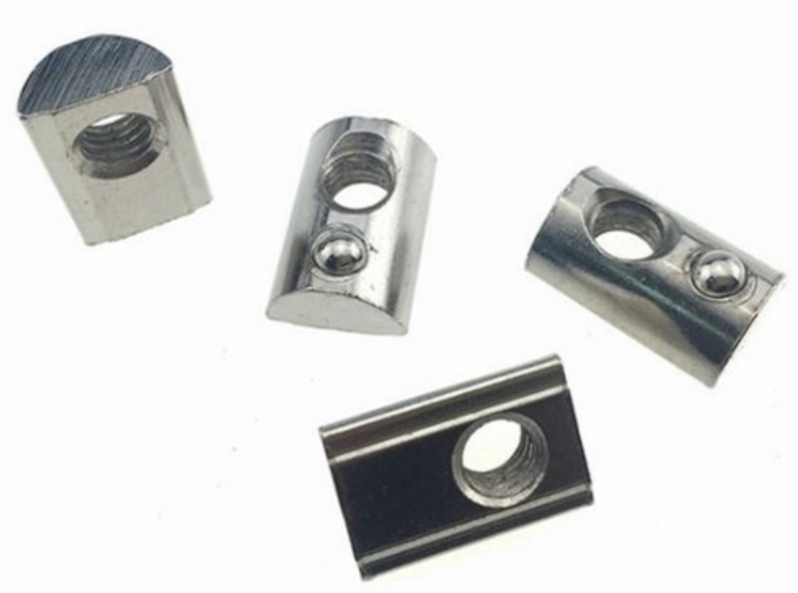
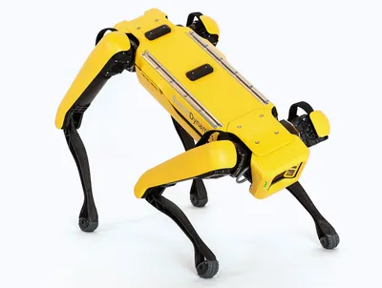
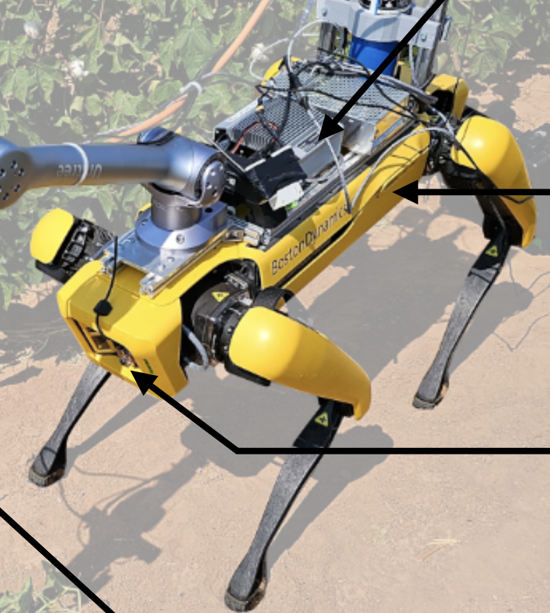
Railing System Research
Railing System
Using the Flamethrower layout as a reference
T-slot Aluminum Extrusion
T-nuts to secure
Use concept generation to begin choosing the best railing system design and layout

Slide 8
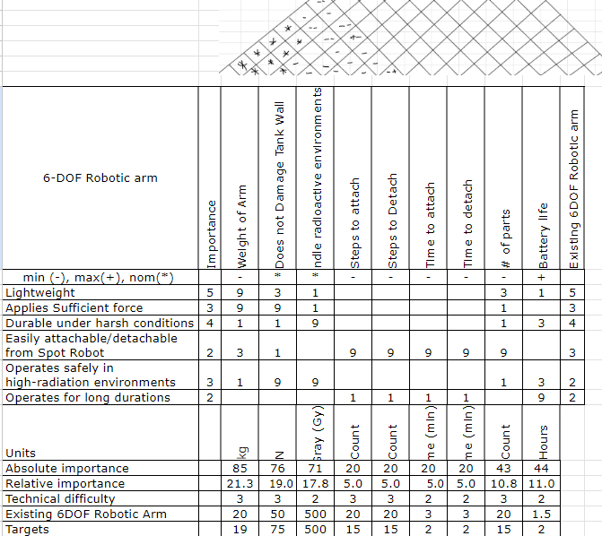
HOQ

Slide 9
Customer Questions
What challenges or problems do you face in your current process for cleaning the wall of the tanks that you think a quadruped robotic arm could help solve?
What features or functionalities would you consider essential for a quadruped robot arm in your operations?
Given that the robot will need to operate in plutonium tanks and apply force to a wall, what particular environmental challenges or constraints (e.g., radiation, space limitations, surface conditions) should we consider in its design?
What specific motions would you expect the robot /robotic arm to handle on a regular basis? (Movement, force)
What are your priorities in terms of performance (e.g., speed, precision, durability)?
What would success look like for you in terms of this robot’s arm capabilities? ( What we need first)
What problems is LANL/DOE currently facing that you think a robotic arm could help solve?
What kind of movements would you want to see out of an arm?
How articulate would the motion have to be?

Slide 10
Codes and Standards
Hanford
DOE Nuclear Facility 420.1C Chg 3 - Link Here
Storage of Radioactive Waste - International Atomic Energy Agency - Link Here
IAEA Tank Farm Technical Safety Requirements - Link Here
DOE Integration of Safety in the Design Process - Link Here
Arm
Industrial Robots and Robot Systems - Link Here
Manipulating Industrial Robots - Link Here

Slide 11
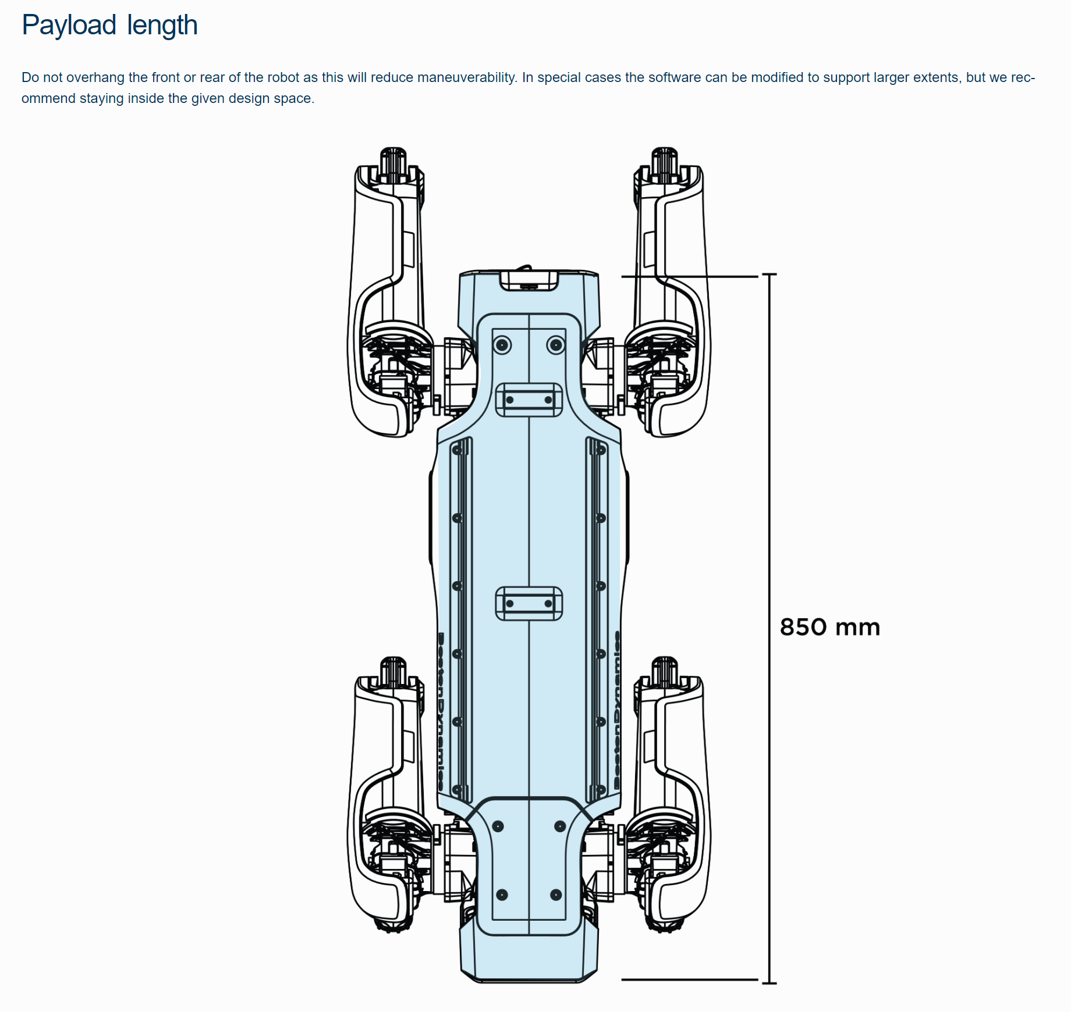
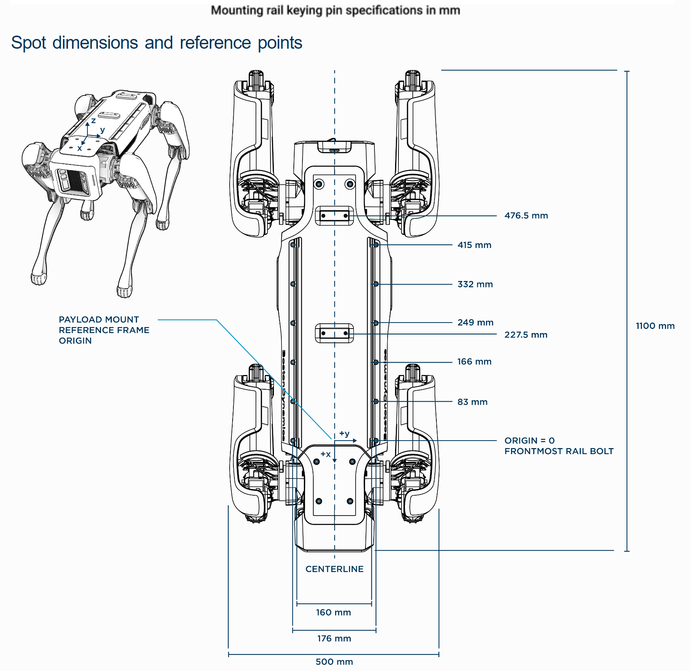
Static Analysis Dimensions
Arm base here

Slide 12
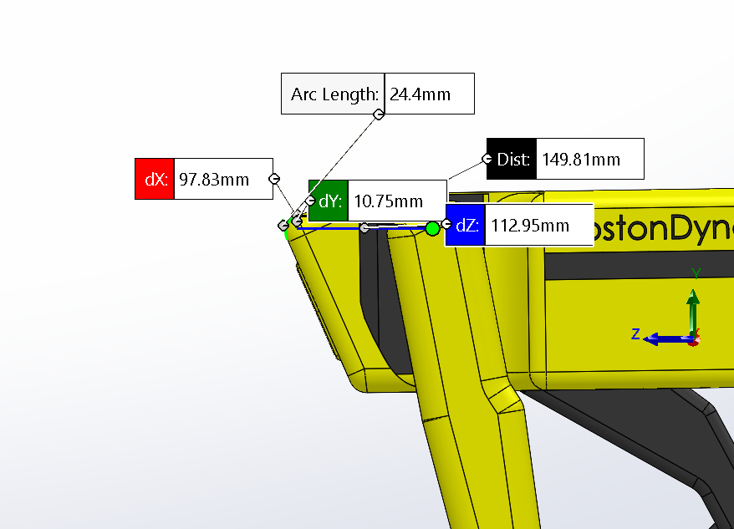
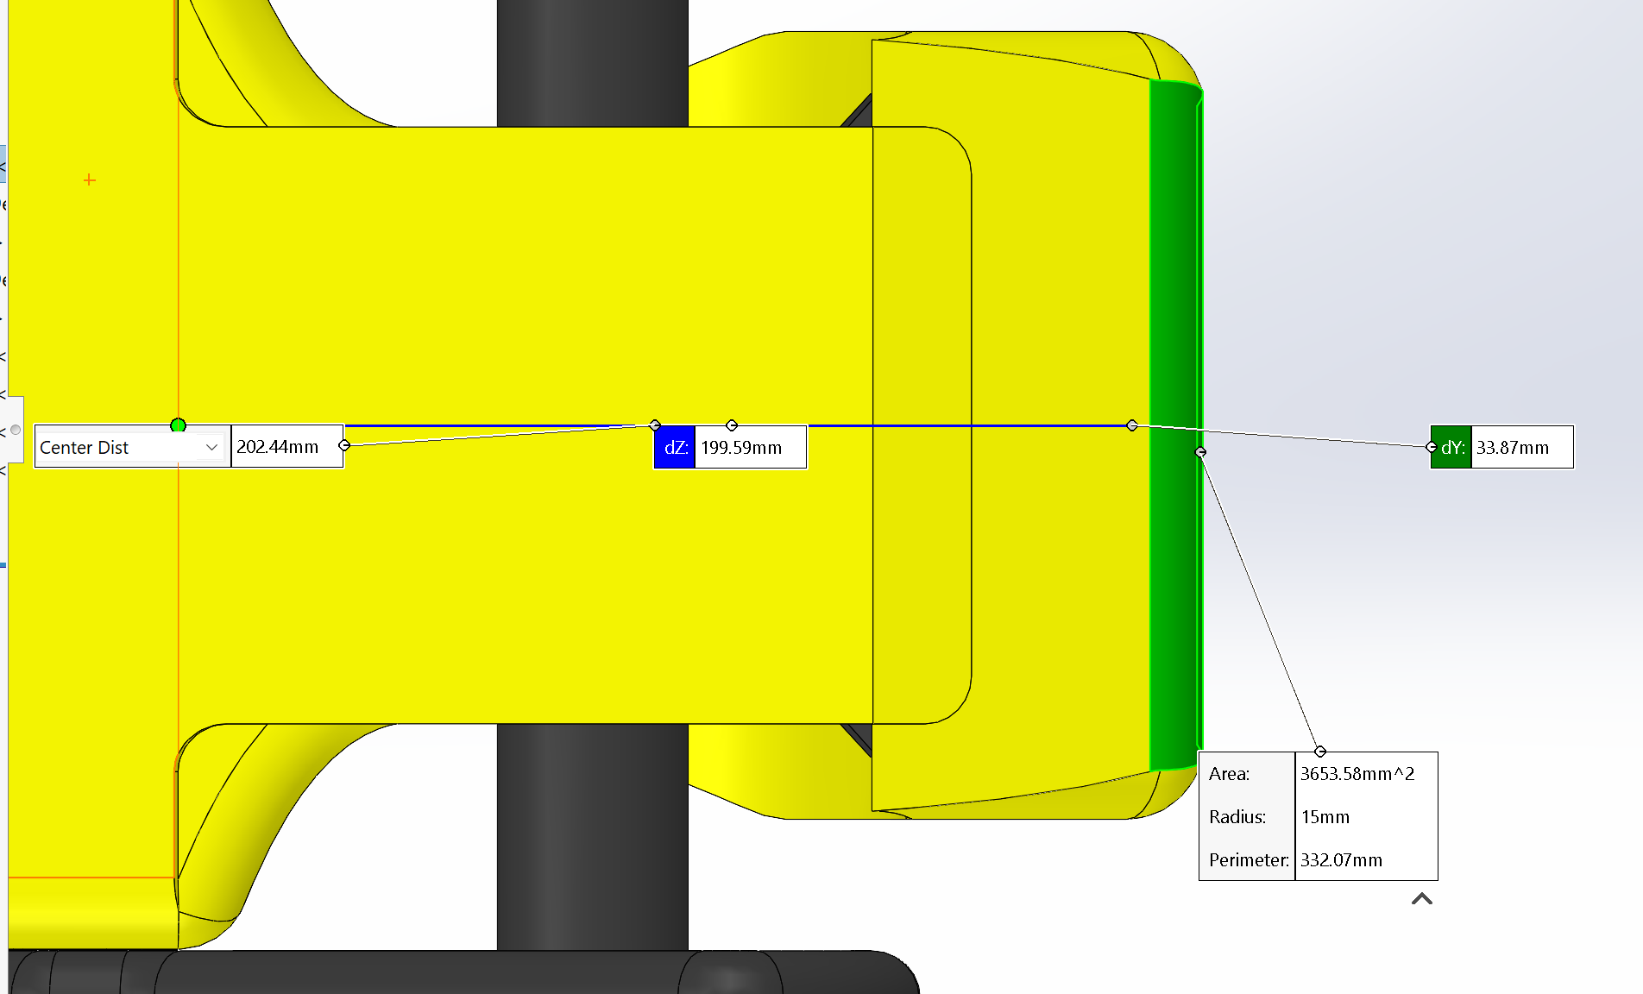
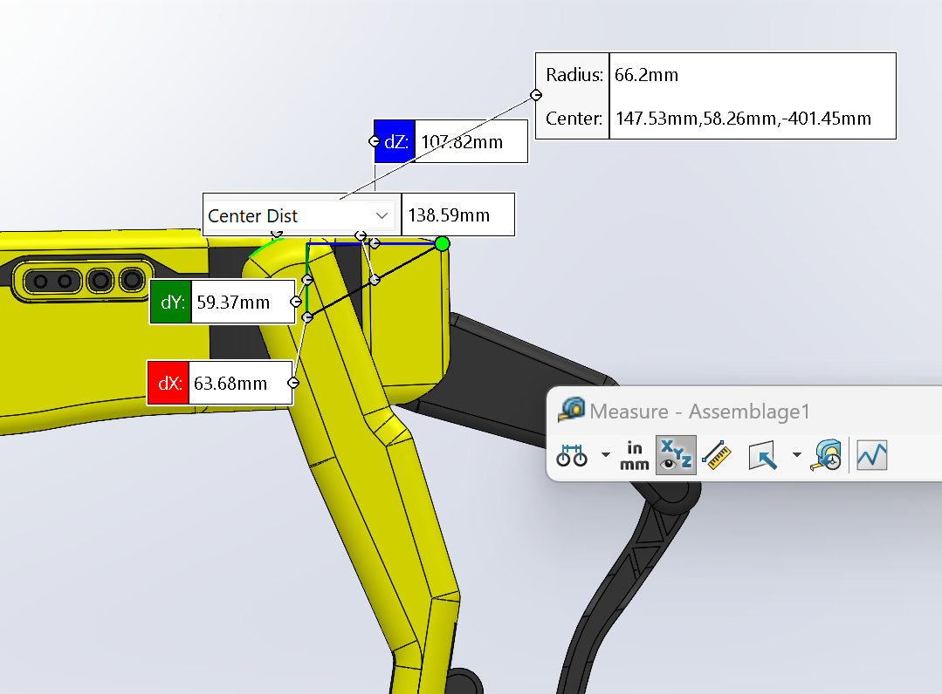
Static Analysis Dimensions

Slide 13
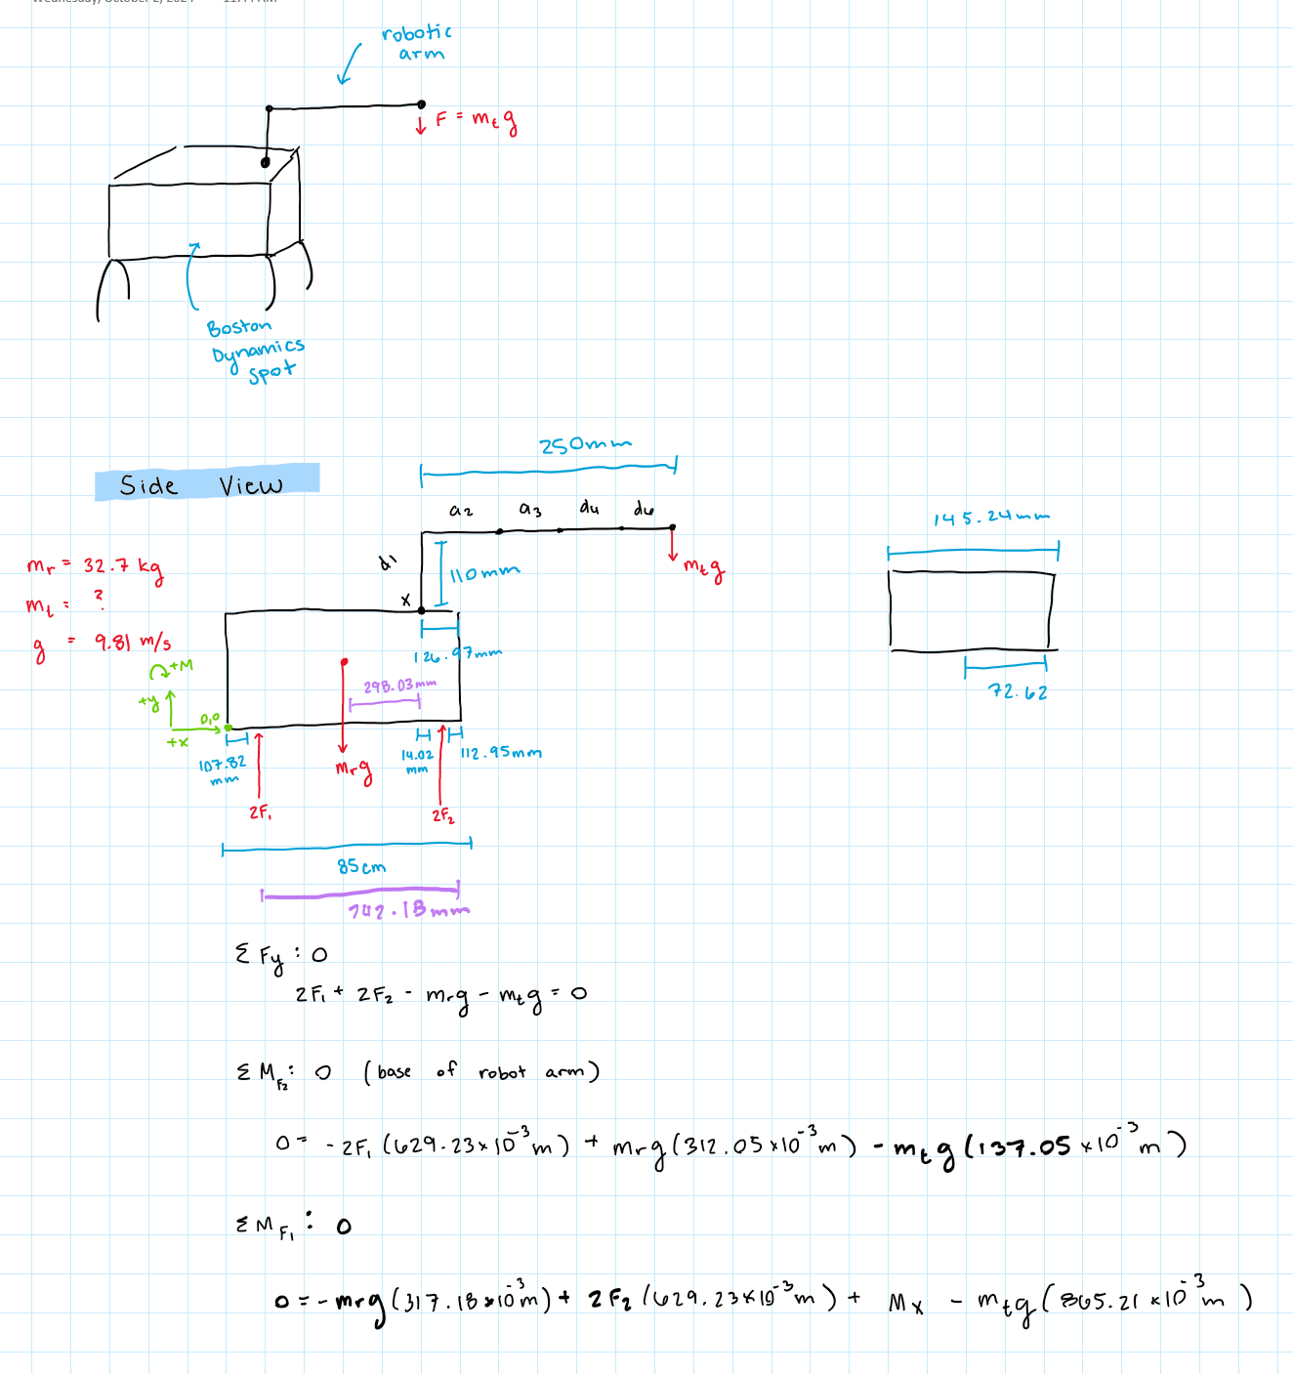
Static Analysis

Slide 14
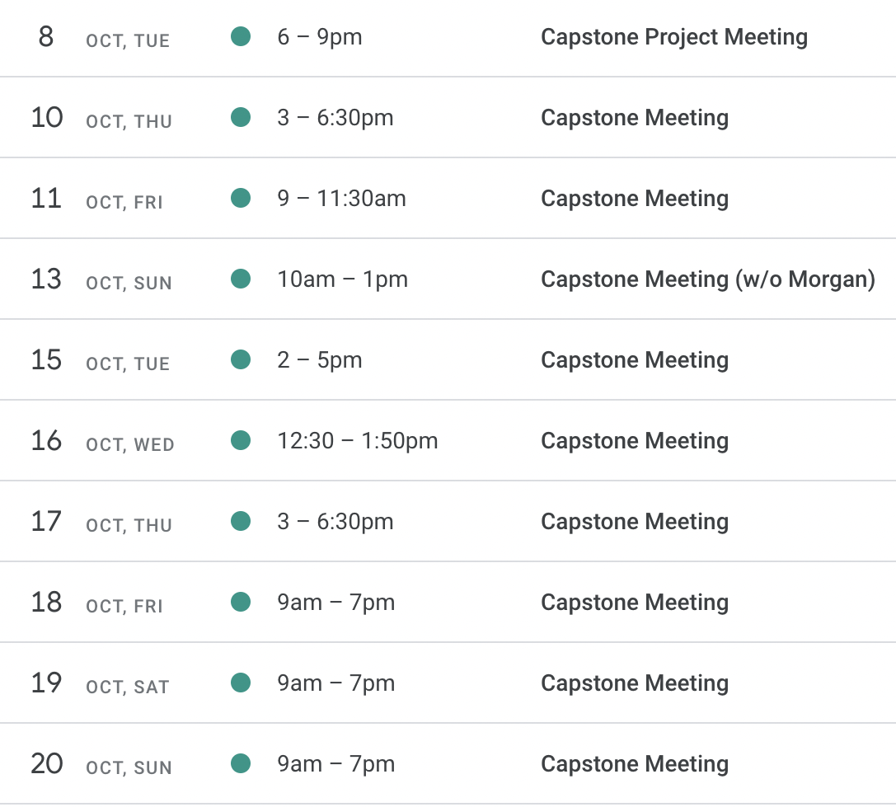
Upcoming Week
Scheduled team meetings for the next 3 weeks before DR2 is due
Scheduled meeting with David for the week after Fall Break
Reschedule customer needs meeting
Complete all DR2 requirements
Begin concept generation

